Slide 2
Inductive Bible
Study Method

Slide 3
Welcome back to IBSM
Bite 05

Slide 4


Slide 5
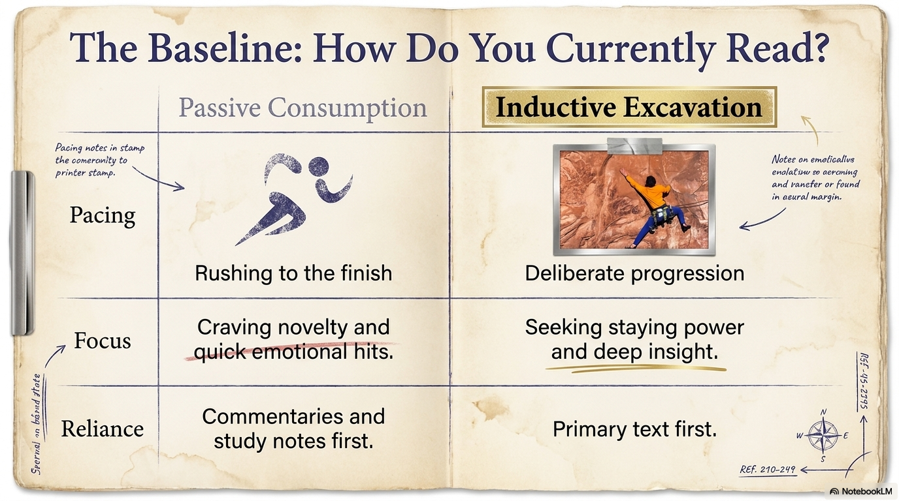

Slide 6

Ten Strategies for First-rate Reading

Slide 7
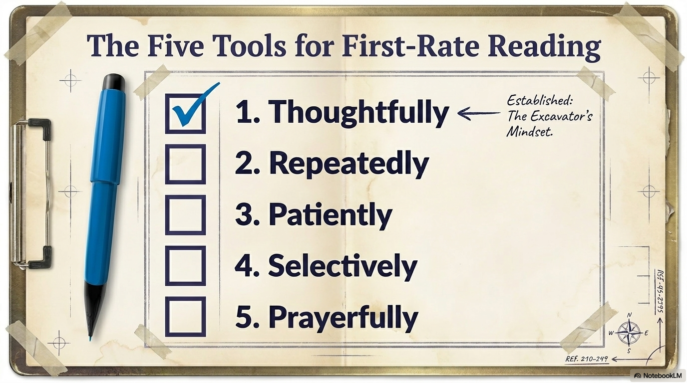

Slide 8
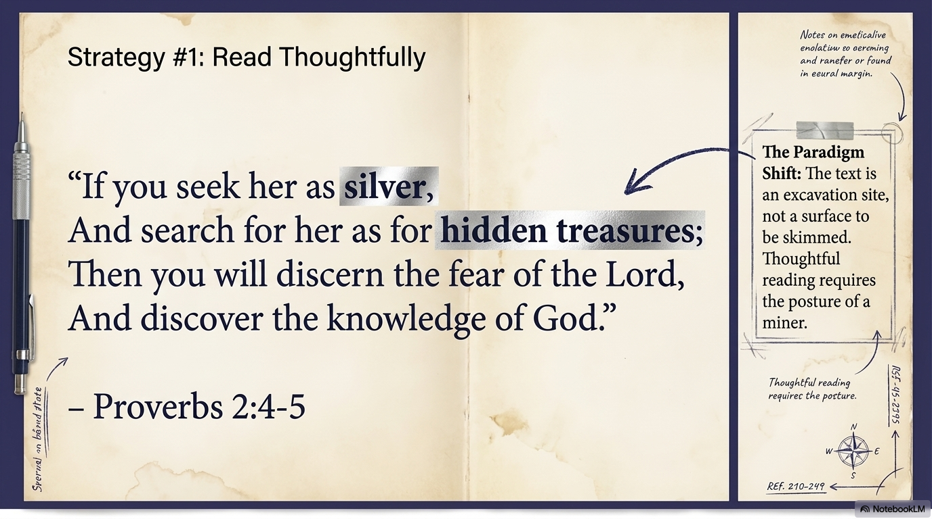

Slide 9
#2 Read repeatedly

Slide 10

2. Read Repeatedly

Slide 11
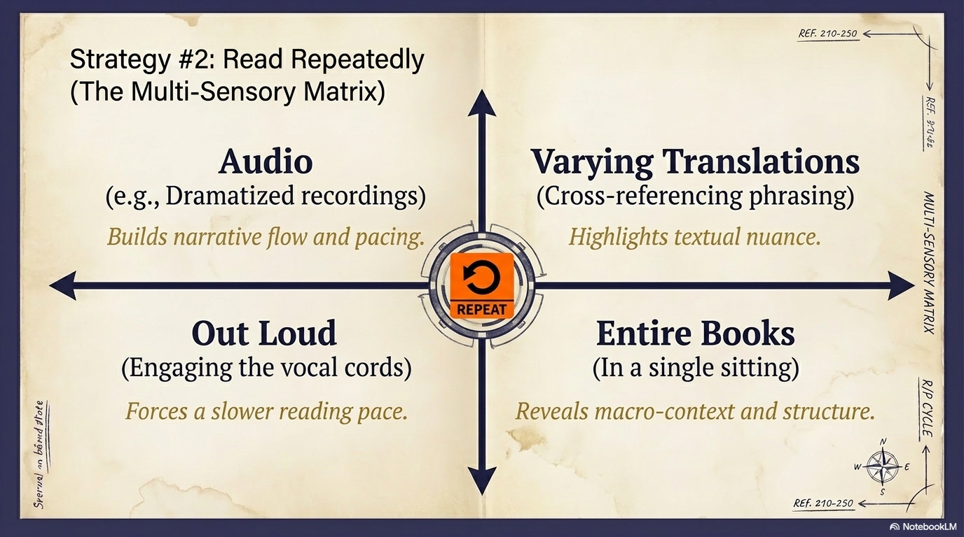

Slide 12
2. Read Repeatedly
How?
Read the Bible in different translations
Listen to recordings of Scripture, for example: Ruth Chapter 2
https://www.biblegateway.com/audio/dramatized/niv/Ruth.1
Read the Bible out loud
Read entire books in one sitting
Notes:
In my personal sermon or bible study preparation, I always read the same passage in in at least 5 translations (NASB, NIV, ESV, NLT, NKJV), that’s before I open up the text in Greek or Hebrew.
Read out loud – Barthemaeus. Mark 10: 46-52
Read once silently
Someone read dramatically.

Slide 13
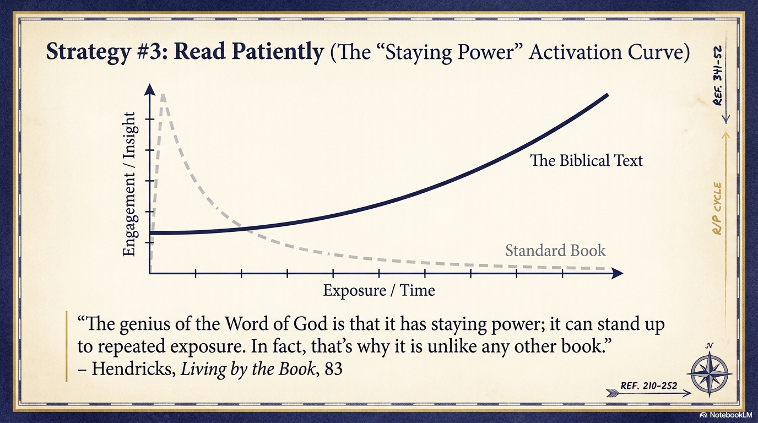

Slide 14

#3 Read patiently

Slide 15

3. Read Patiently

Slide 16


Slide 17
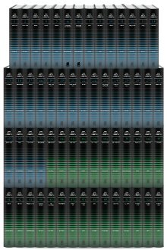

3. Reading Patiently
DO NOT run to the secondary sources as your first stop!
Notes:
- “most people quit too soon”…they prefer to jump to secondary sources.
- only use secondary sources AFTER you have patiently explored the text yourself.

Slide 18

3. Read Patiently
Two Principles:
Be patient with the text
Be patient with yourself
Notes:
Be patient with yourself
During my first semester in seminary, I felt a bit overwhelmed and discouraged. Many of my colleagues came from Bible college and did their undergrad in Bible, so when it came to doing Bible exercises, they were fast, they were seeing all sorts of things that I missed.
But Dr. Hendricks encouraged me. He taught be to be patient. He taught me not to compare myself with other students. He taught me not to quit too soon.

Slide 19
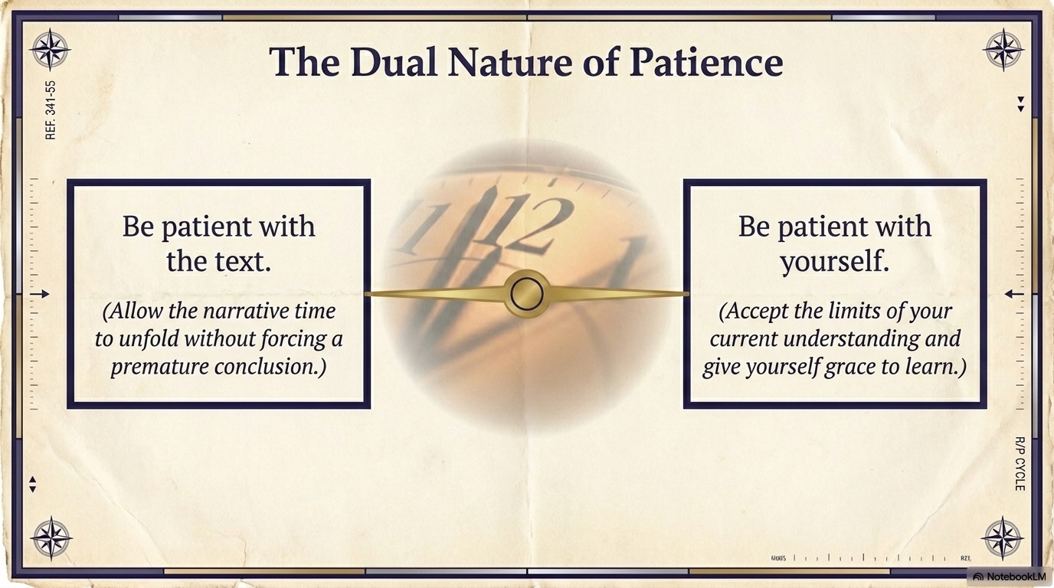

Slide 20
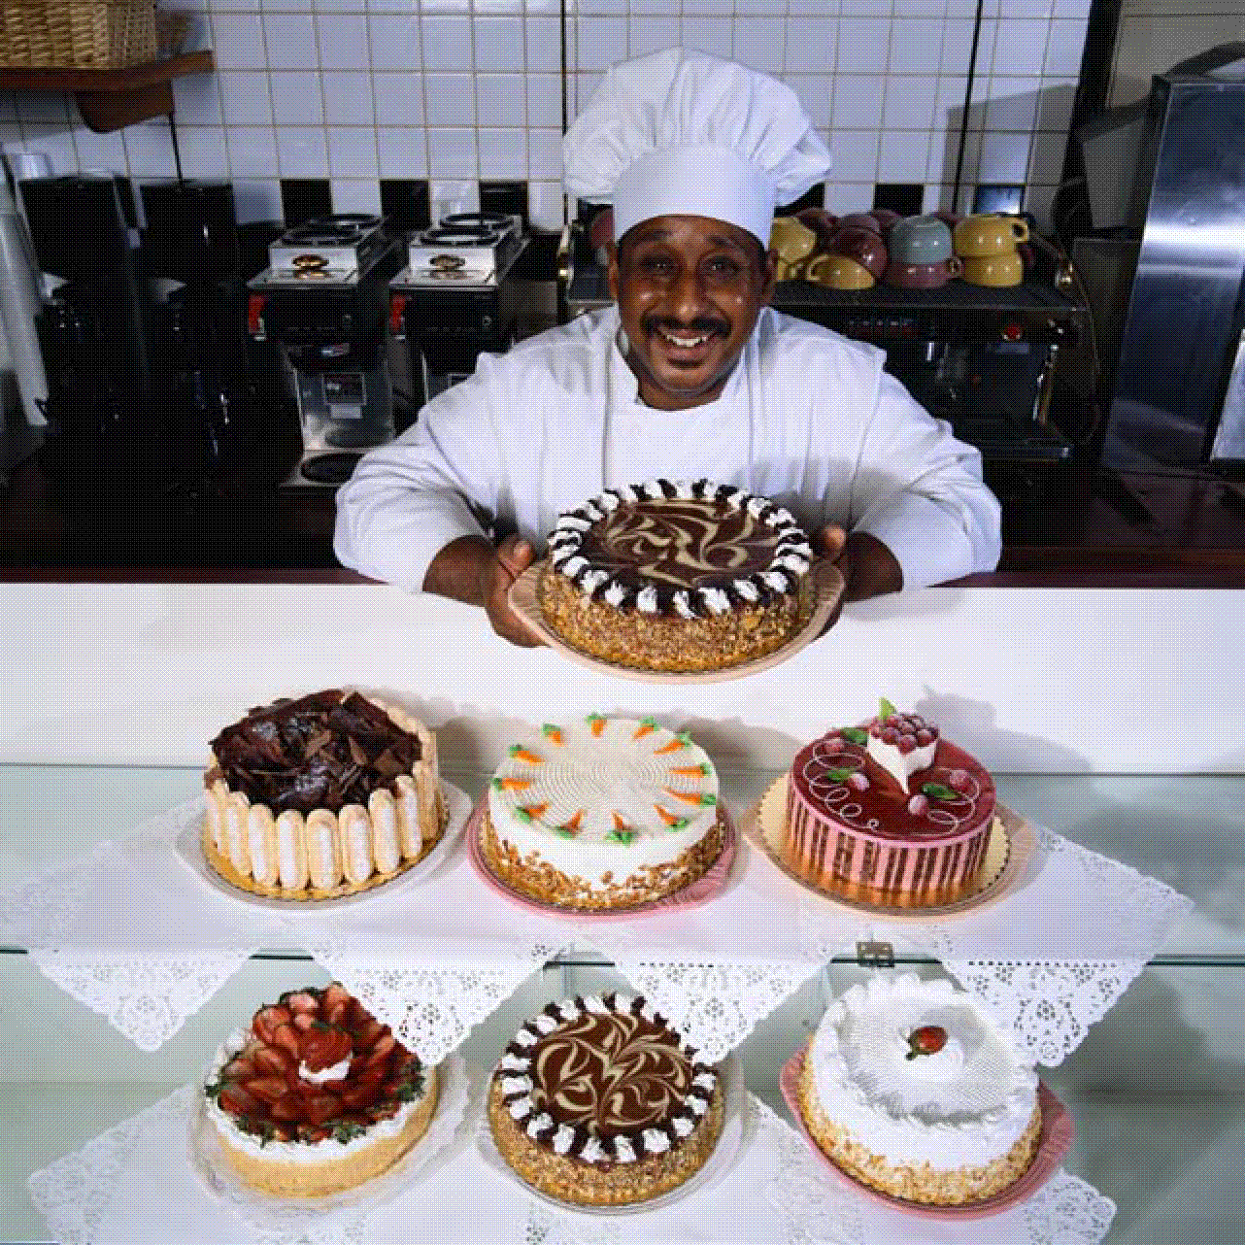
#4 Read selectively

Slide 21
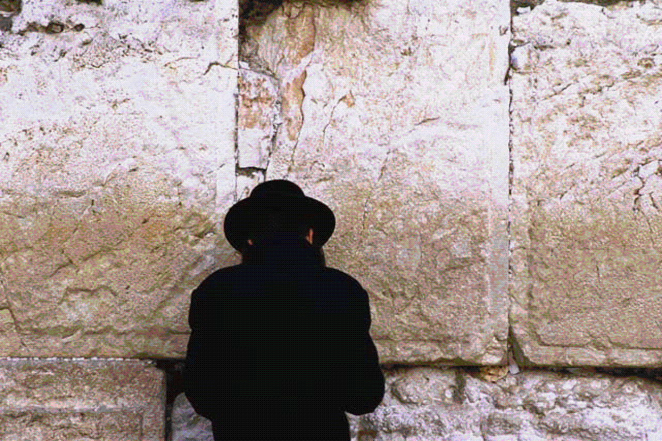
#5 Read prayerfully

Slide 22
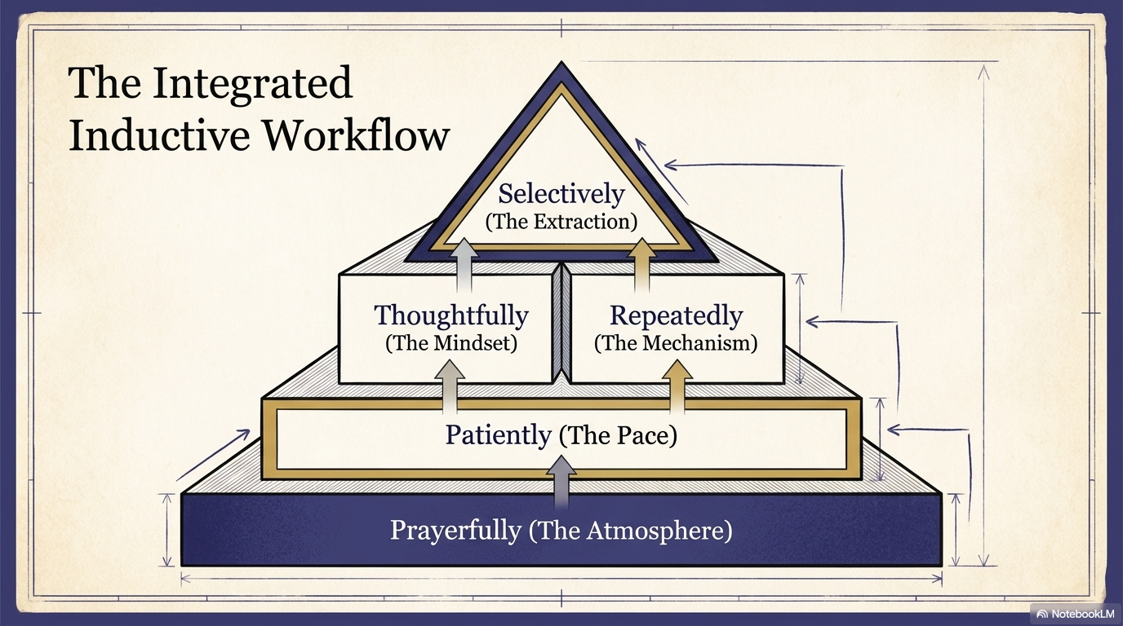

Slide 23


Slide 24


